Slide 1
EMPLOYEE DATA ANALYSIS USING EXCEL
NAME : K. NAVANEETHA KUMAR
REGISTER NO : asunm110312201259
DEPARTMENT : DEPARTMENT OF COMMERCE
COLLEGE : D.R.B.C.C.C. HINDU COLLEGE

Slide 2



PROJECT TITLE
EMPLOYEE PERFORMANCE USING EXCEL

Slide 3

AGENDA
Problem Statement
Project Overview
End Users
Our Solution and Proposition
Dataset Description
Modelling Approach
Results and Discussion
Conclusion

Slide 4

PROBLEM STATEMENT
This project focuses on analyzing employee growth through a structured performance measurement framework. The goal is to objectively assess contributions, identify areas for improvement, and recognize high performers to ensure alignment with the company’s strategic goals.
The framework provides actionable insights to enhance productivity, helping managers guide individual efforts toward overall organizational success. By combining constructive feedback with positive reinforcement, it fosters a culture of fairness, accountability, and continuous improvement.
Ultimately, this project aims to optimize employee performance, driving better decision-making and supporting long-term growth within the organization.

Slide 5

PROJECT OVERVIEW
This project is designed to help track and improve employee growth using a clear and structured performance measurement framework. The aim is to provide an objective assessment of each employee's contributions, highlighting strengths, identifying areas where improvement is needed, and recognizing top performers. This ensures that everyone's efforts are aligned with the company’s bigger strategic goals.The framework delivers useful insights that enhance productivity, allowing managers to guide individual efforts in a way that benefits the entire organization. By blending constructive feedback with positive recognition, it promotes a workplace culture grounded in fairness, accountability, and continuous development.In the long run, this approach is about optimizing employee performance, helping leaders make better decisions, and driving sustained growth for the organization.

Slide 6

WHO ARE THE END USERS
Managers and Supervisors: Use the insights to assess employee performance, provide feedback, and guide development. Make informed decisions about promotions, rewards, and training needs.
Human Resources (HR) Teams: Monitor overall workforce performance and identify trends. Develop strategies for talent management, retention, and succession planning.
Employees: Gain clarity on their performance, areas for improvement, and career development opportunities. Understand how their contributions align with organizational goals.
Executives and Leadership: Use performance data to evaluate organizational productivity. Make strategic decisions about resource allocation, growth plans, and team effectiveness.
Organizational Development Teams: Identify skills gaps and create programs for continuous improvement and employee engagement.

Slide 7

OUR SOLUTION AND ITS VALUE PROPOSITION
1. Conditional Formatting (Missing Data): Highlighted blank cells to easily identify missing or incomplete data that needed attention.
2. Filtering (Data Clean-up):. Applied filters to remove incomplete entries, ensuring that only complete and accurate data was analyzed
3. Formula (Performance Calculation): Used formulas to calculate and compare performance levels, allowing for quick and efficient data assessment.
4. Pivot Table (Data Summary): Created pivot tables to summarize and organize data, making it easier to identify trends and patterns
5. Graph Data (Visual Representation): Developed graphs to visually represent the data, enabling quick recognition of performance trends and insights.

Slide 8


DATASET DESCRIPTION
IN EMPLOYEE DATA THERE ARE 12 FEATURES WERE LISTED BELOW.
1. Employee ID: A unique number assigned to each employee for identification purposes.
2. Age: The employee’s age, which can provide insights into their experience or level of seniority
3. Gender: The employee’s gender, useful for demographic and diversity analysis.
4. Department: The division within the company where the employee works, such as IT, HR, or Sales.
5. Job Role: The employee’s specific position or title, such as Manager, Analyst, or Developer.
6. Salary : The employee’s compensation, which can be analyzed to understand pay scales and trends across different roles and departments.
7. Years of Experience: The total amount of work experience the employee has, including both current and prior roles.
8. Performance Rating: A score or rating assigned to the employee based on their job performance, typically on a scale of 1 to 5.
9. Years at Company: The duration the employee has been with the company, used to examine retention and turnover patterns.
10. Training Hours: The number of hours the employee has spent in professional development or training programs.
11. Overtime: Whether the employee works overtime (yes or no), which may relate to job stress or engagement.
12. Attrition: Indicates if the employee has left the company (yes or no), useful for analyzing turnover rates.

Slide 9

THE “WOW” IN OUR SOLUTION
Formula Performance: This involves using Excel formulas to compute and analyze employee performance metrics, simplifying the assessment of productivity and efficiency. These formulas automate the evaluation process, delivering rapid and precise insights into both individual and team performance.
=IFS(Z8>=5,"VERY HIGH",Z8>=4,"HIGH",Z8>=3,"MED", TRUE, "LOW")

Slide 10

MODELLING
1. Data Collection:
- Collected employee data from various sources, including records and databases.
- Gathered information such as employee IDs, names, exit dates, business units, status, type, and performance scores.
2. Feature Extraction:
- Identified and extracted key features for analysis.
- Included attributes such as employee classification, gender, performance scores, and current ratings.
3. Data Cleaning:
- Applied conditional formatting to highlight missing values.
- Used filters to remove blank cells and addressed inconsistencies.
4. Performance Level:
- Applied formulas to calculate performance levels from scores and ratings.
- Categorized employees into high, medium, and low performance tiers.
5. Summary:
- Created pivot tables to condense and organize large data sets.
- Provided a clear overview of employee performance trends.
6. Visualization :
- Used graphs, pie charts, and trend lines to represent the data visually.
- Simplified the interpretation of performance trends.

Slide 11
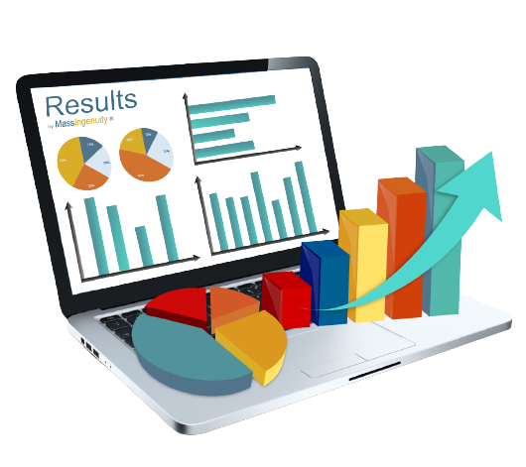
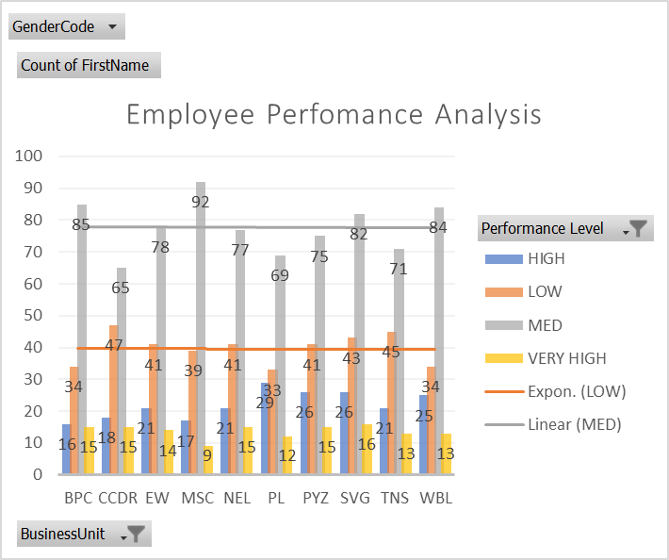
RESULTS

Slide 12

CONCLUSION
This project effectively employed Excel to analyze employee performance, ensuring accurate data handling through techniques like conditional formatting, filtering, and data cleaning. By gathering relevant features and summarizing data with pivot tables, it provided a clear view of performance trends. Formulas were used to categorize employees into different performance levels, helping to identify both high achievers and areas needing improvement. Visualizations, such as graphs and charts, made it easier to understand and communicate these insights, facilitating informed decision-making. Overall, the project showcased the effectiveness of data analysis and visualization in enhancing employee performance evaluation.

Slide 13

THANK YOU !...

